Slide 1

Leveraging predictability of deep learning techniques on financial time series forecasting
GITAM
(Deemed to be University)
School of Technology, Hyderabad
Department of Computer Science and Engineering
PROJECT BATCH NO. : P10-15 GUIDE NAME:-
NAME OF THE STUDENTS:- PROF. SARAT CHANDRA NAYAK
SRI VAISHNAVI VASA (HU21CSEN0100673)
LEENA DEEKOLLU (HU21CSEN0100741)
BINDU SRI (HU21CSEN0101184)

Slide 2
CONTENTS
OVERVIEW
ANALYSIS & DESIGN BASED ON PROBLEM STATEMENT
ANALYSIS OF METHODOLOGY
CONCLUSION

Slide 3
OVERVIEW

Slide 4
ABSTRACT:
Financial time series forecasting has become a vital focus within computational intelligence, engaging finance researchers in academia and industry alike due to its broad applications and substantial impact. While numerous Machine Learning (ML) models have been developed for this purpose, an extensive array of surveys already exists covering ML applications in financial forecasting.
More recently, Deep Learning (DL) models have entered the field, showing significant performance improvements over traditional ML methods. However, despite the growing interest in DL for financial time series forecasting, there is a notable lack of research focused specifically on DL applications for finance, particularly for region-specific data. This research aims to bridge this gap by experimenting with various DL models to optimize forecasting accuracy specifically for the Bombay Stock Exchange. Through this study, we seek not only to review current DL approaches but also to identify, improve, and potentially introduce a novel model tailored to Indian stock data. In addition to providing a comprehensive review, this research highlights potential setbacks and emerging opportunities in DL for financial forecasting, offering insights valuable to future researchers in the field.

Slide 5
PROBLEM STATEMENT:
Financial time series forecasting faces significant challenges that can compromise the accuracy and reliability of predictions. Issues such as data quality, including missing values and gaps in historical records, pose considerable hurdles for forecasting models. Additionally, nonstationarity in financial data, often caused by structural breaks from market regulations or global events, complicates the modeling process. The inherent volatility and uncertainty of financial markets further necessitate advanced modeling techniques capable of capturing the complex, nonlinear relationships among variables, as traditional linear models may not adequately reflect the dynamics of these systems.
Despite the increasing interest in deep learning (DL) techniques, there is a notable lack of comprehensive literature reviews focusing on their implementation and effectiveness in financial time series forecasting. This research aims to fill this gap by systematically reviewing existing DL methodologies, highlighting their strengths and weaknesses, and evaluating their predictability in overcoming common challenges such as overfitting and model generalization. Furthermore, we will experiment with various DL models on financial datasets, specifically focusing on the Bombay Stock Exchange, to identify an optimized model for this context. By leveraging the predictive capabilities of DL, this study seeks to enhance forecasting accuracy, ultimately contributing to improved decision-making processes within the finance industry.

Slide 6
ANALYSIS AND DESIGN

Slide 7
DATASET AND DATA ANALYSIS
Selected Dataset : BSE (Bombay Stock Exchange) SENSEX Next 50
The BSE SENSEX Next 50 TMC is designed to measure the performance of the 50 largest and most liquid companies within the BSE 500 that are not members of the BSE SENSEX 50 TMC.
Long Historical Data: Established in 1875, BSE offers extensive historical data, beneficial for identifying long-term trends and cycles.
Diverse Company Listings: Includes a broad range of industries, especially small and mid-cap companies, providing a more comprehensive view of the Indian economy.
Broader Market Representation: BSE’s SENSEX index reflects general market sentiment and serves as an economic barometer.
Greater Volatility: The inclusion of smaller stocks introduces more volatility, useful for forecasting market sentiment and risk.
Unique Insights from Trading Volumes: BSE’s data includes lower-volume trades, helping model less-liquid asset behavior.
Event Sensitivity: BSE data reflects responses to major events like COVID-19, financial scams, and policy shifts, providing insight into how markets react to crises.

Slide 8
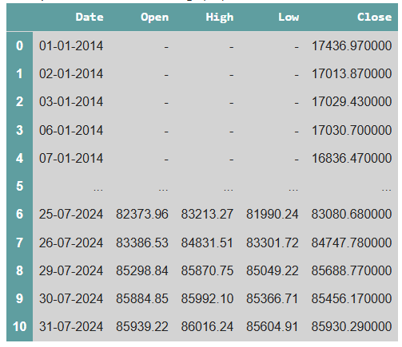
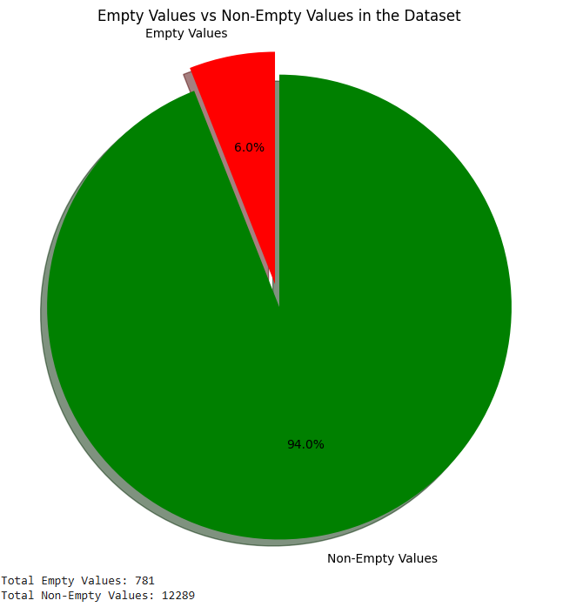
Fig 1: Overall analysis of training data being considered downloaded from BSE official website.
(Notice how it contains anomalies because of some rows being empty)

Slide 9
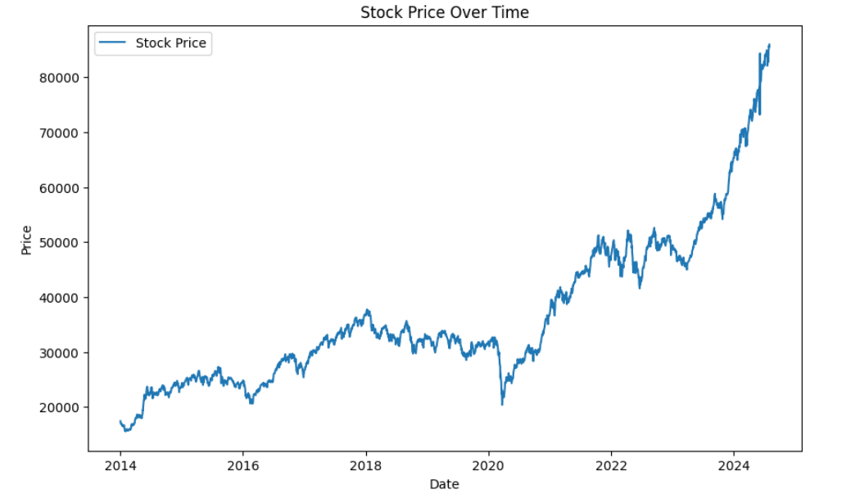
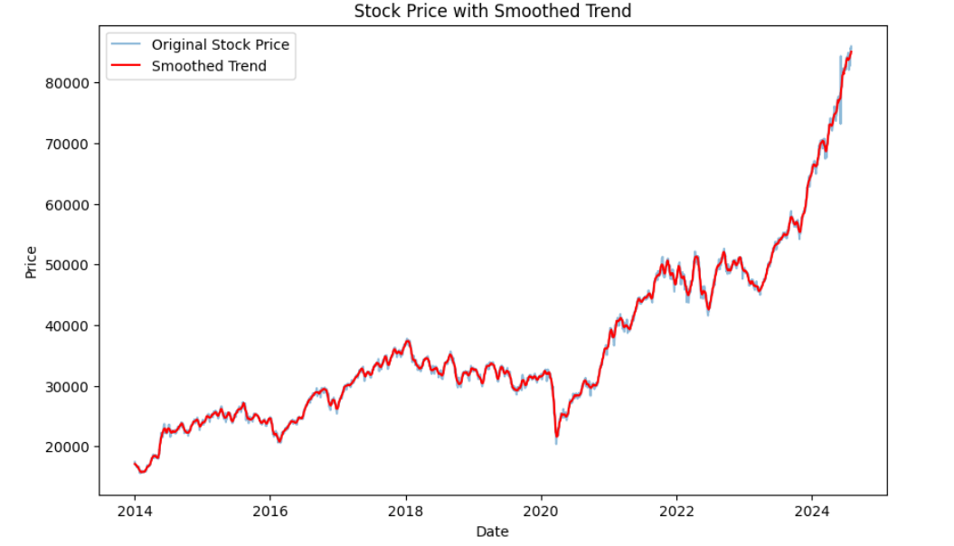
Fig 3: After applying a simple smoothing filter to see the long-term trend (Savgol Filter)
Fig 2: Relationship of stock price (closing price) each year

Slide 10
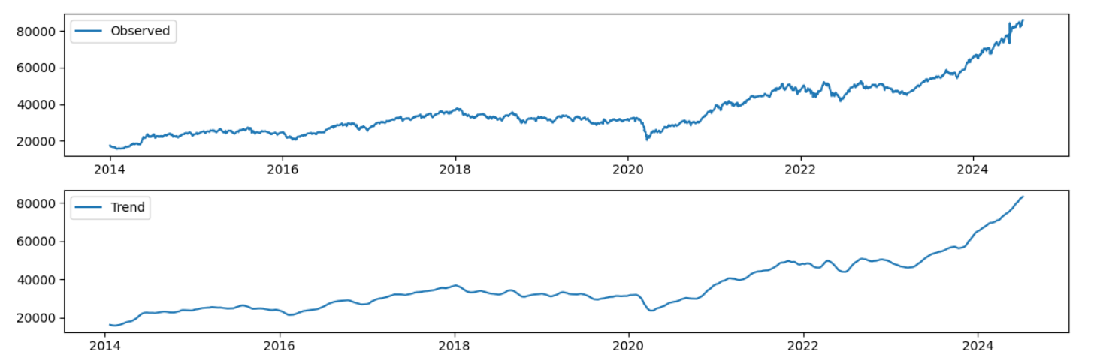
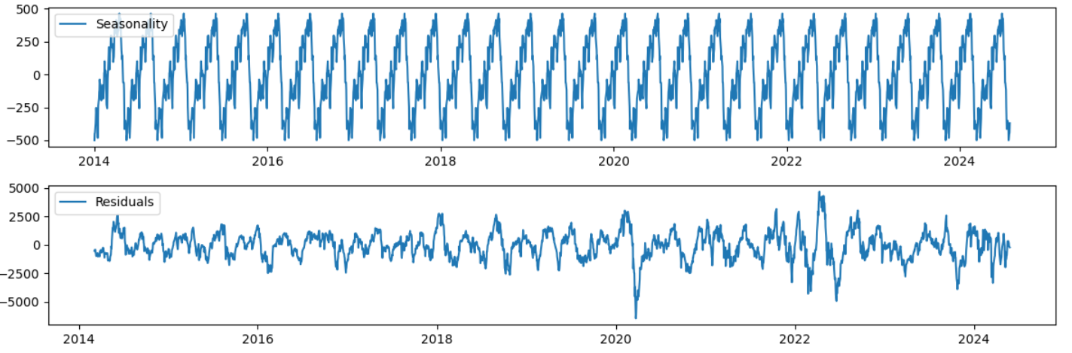
Fig 4: Time Series Trends which includes checking for recurring patterns, change in values etc.

Slide 11
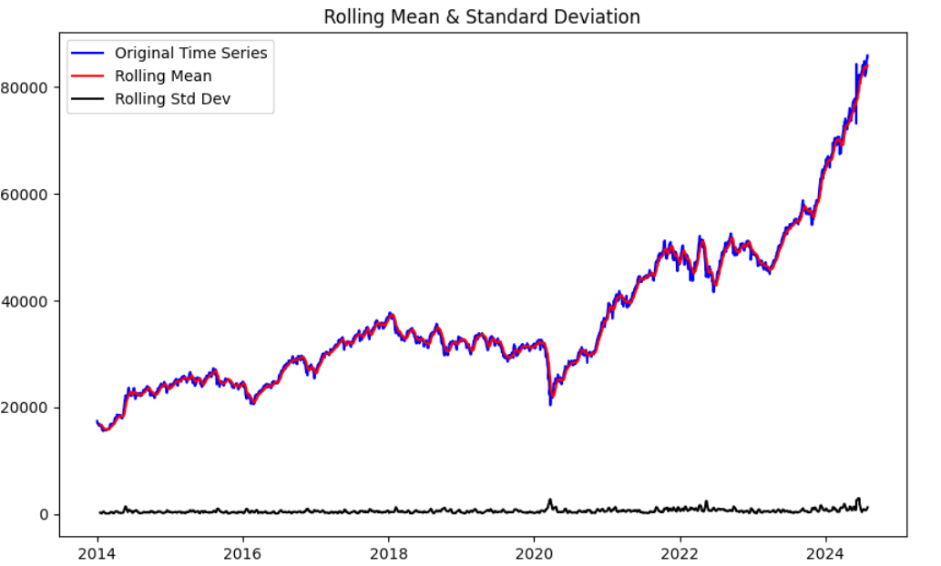
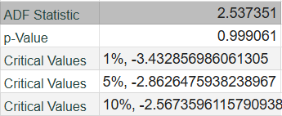
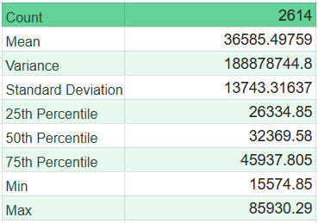
Fig 5: ADF(Augmented Dickey-Fuller) Test on the given data
Fig 6: Descriptive Statistics for Closing Price

Slide 12
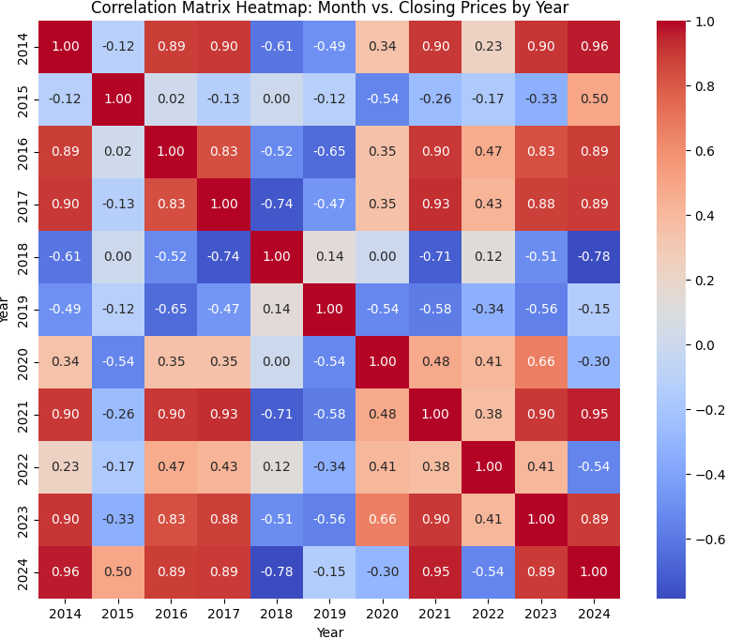
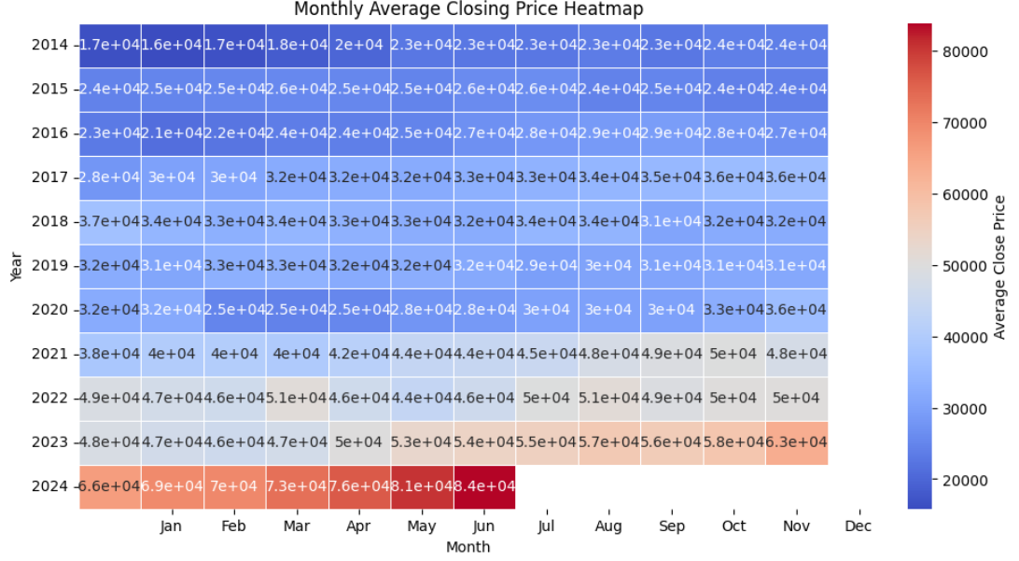
Fig 7: Correlation matrix between Closing price against each year
Fig 8: Comparison of monthly average closing price against each year

Slide 13
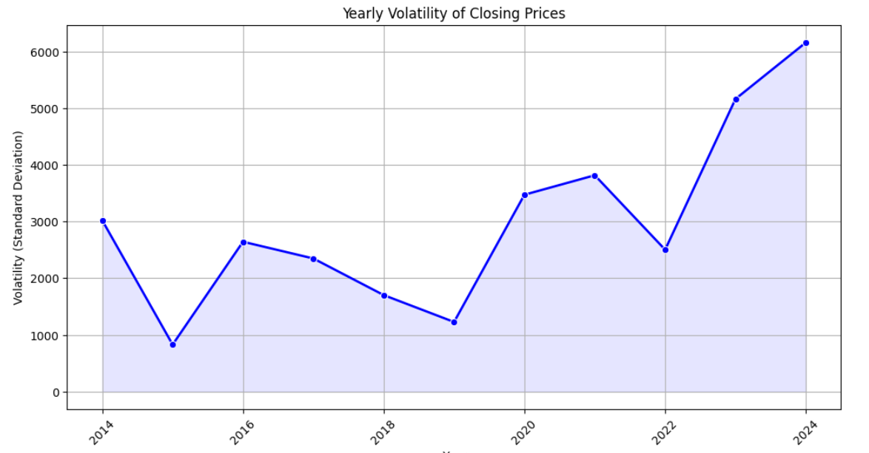
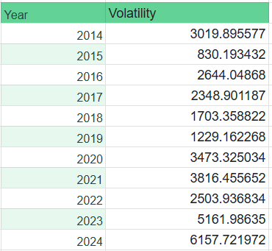
Fig 9: The graph illustrates the yearly volatility of the closing prices.
High volatility indicates significant price fluctuations, while low volatility suggests relative stability.
CONCLUSION:
The dataset exhibits significant fluctuations, making it challenging for predictive modeling. Such volatile data can be difficult to capture with traditional time series models, as they often assume underlying patterns and trends.
Deep learning models, especially those designed for time series data, like Recurrent Neural Networks (RNNs) and Long Short-Term Memory (LSTM) networks, can be more effective in handling these fluctuations. However, they require careful feature engineering, hyperparameter tuning, and potential data augmentation to improve accuracy.

Slide 14
EVALUATION CRITERIA
REGRESSION TEST PARAMETERS
These are used to evaluate prediction accuracy, error size, and the model's ability to capture variance in the data, essential for applications like financial forecasting or sales predictions.
1. Mean Absolute Error (MAE): The average of the absolute differences between predicted and actual values. MAE provides a straightforward measure of accuracy, with lower values indicating better performance.
2.Mean Squared Error (MSE): The average of squared differences between predicted and actual values. MSE penalizes larger errors more than smaller ones, making it useful when large errors are undesirable.
3.Root Mean Squared Error (RMSE): The square root of MSE, which has the same unit as the target variable. RMSE is commonly used when interpretability in the target’s unit is important.
4.Mean Absolute Percentage Error (MAPE): Measures average percentage error between predictions and actuals. Scale-independent, making it useful for varied data ranges; lower MAPE indicates higher accuracy.

Slide 15
BINARY CLASSIFIERS
A binary classifier can be quite useful for financial time series forecasting, especially when the primary goal is to predict a directional outcome, such as whether a stock price or financial metric will increase or decrease within a given period.
1.Accuracy: Measures the percentage of correct predictions (both positive and negative) made by the model out of all predictions. Useful when class distribution is balanced.
2.Precision: The ratio of true positives (correctly predicted positive cases) to the total predicted positives. It is crucial when false positives are costly, as it shows the proportion of relevant instances among those predicted as positive.
3.Recall (Sensitivity): The ratio of true positives to the actual positives. Recall is essential when false negatives are costly, showing how well the model detects actual positive cases.
4.F1 Score: The harmonic mean of precision and recall. F1 Score is beneficial when there’s an uneven class distribution, balancing precision and recall to provide a single metric for performance.
5.ROC-AUC (Receiver Operating Characteristic - Area Under Curve): This measures the classifier's ability to distinguish between classes by plotting true positive rate against false positive rate. It provides a score from 0 to 1, with higher values indicating better performance across thresholds.

Slide 16
IMPLEMENTATION
OVERVIEW OF TECHNOLOGIES
Python
Google Colab
LIBRARIES IMPORTED
Pandas
Numpy
Scikit
Keras
Statsmodel
pmdarima

Slide 17
ANALYSIS OF
EXISTING METHODOLOGY

Slide 18
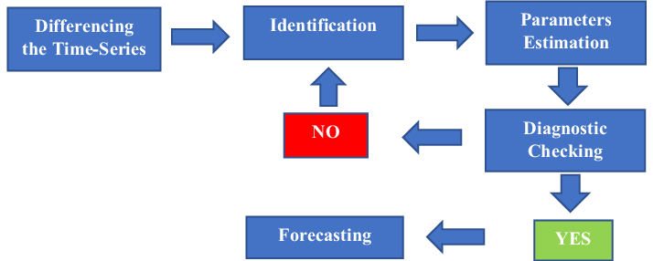
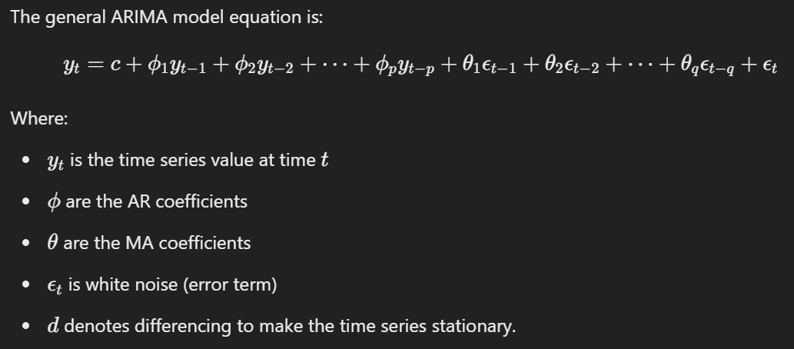
ARIMA
ARIMA models are statistical tools used to analyze and predict time series data. They break down time series into three components:
Autoregression (AR): Uses past values of the series to predict future values.
Integration (I): Makes the series stationary by differencing.
Moving Average (MA): Uses past errors in the model to predict future values.
ARIMA(p,d,q) where;
p → order of autoregressive model
d → degree of differencing
q → order of the moving average model
Fig 10: Block Diagram of ARIMA model
Fig 11: Equation of ARIMA model

Slide 19
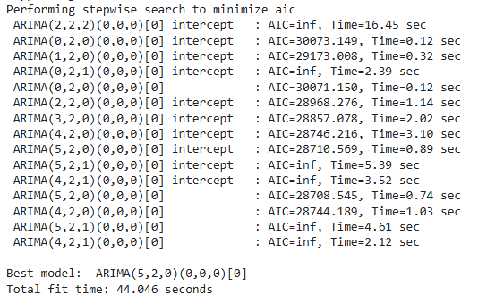
Fig 12: Using pmdarima to automate the process of choosing best value of p,d,q
In PMDARIMA, a Python library used for time series forecasting, AIC refers to the Akaike Information Criterion which is a metric used to compare different statistical models, particularly in time series analysis, and it helps in model selection.

Slide 20
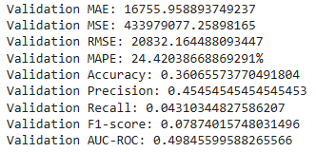
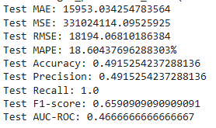
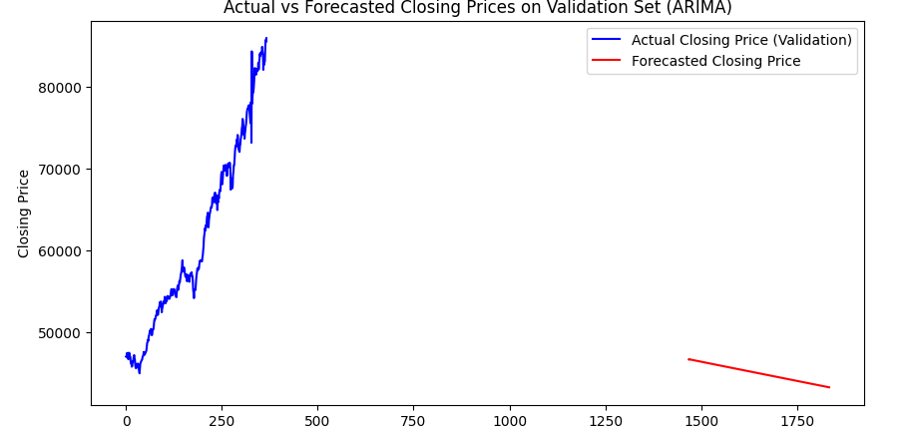
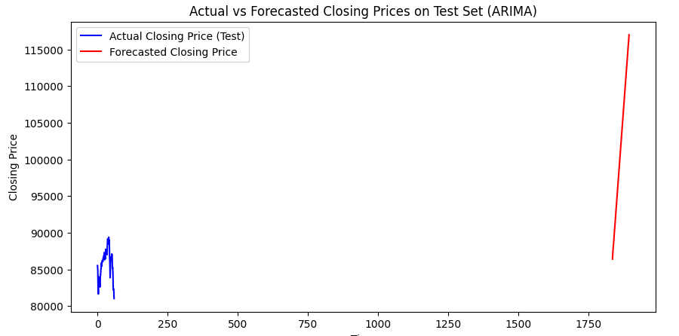
Fig 13: Parameters obtained upon execution of ARIMA model over training and testing dataset (without threshold and shift)

Slide 21
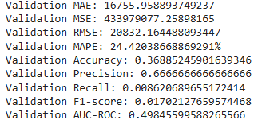
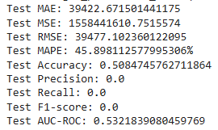
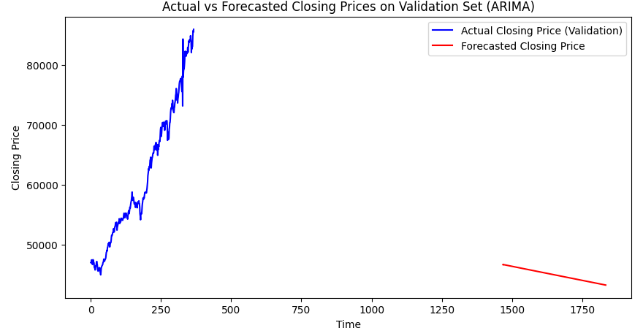
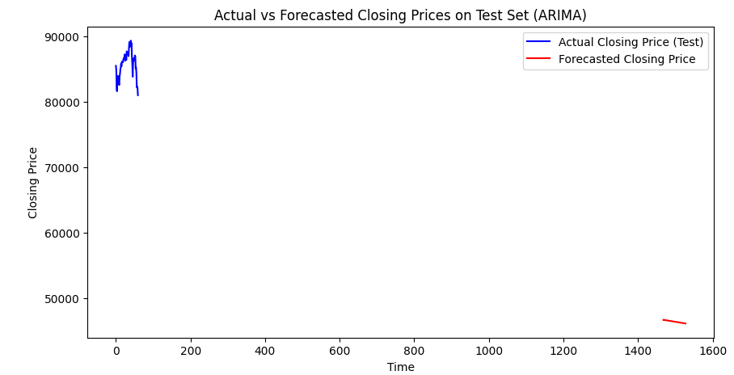
Fig 14: Parameters obtained upon execution of ARIMA model over training and testing dataset (with threshold and shift)

Slide 22
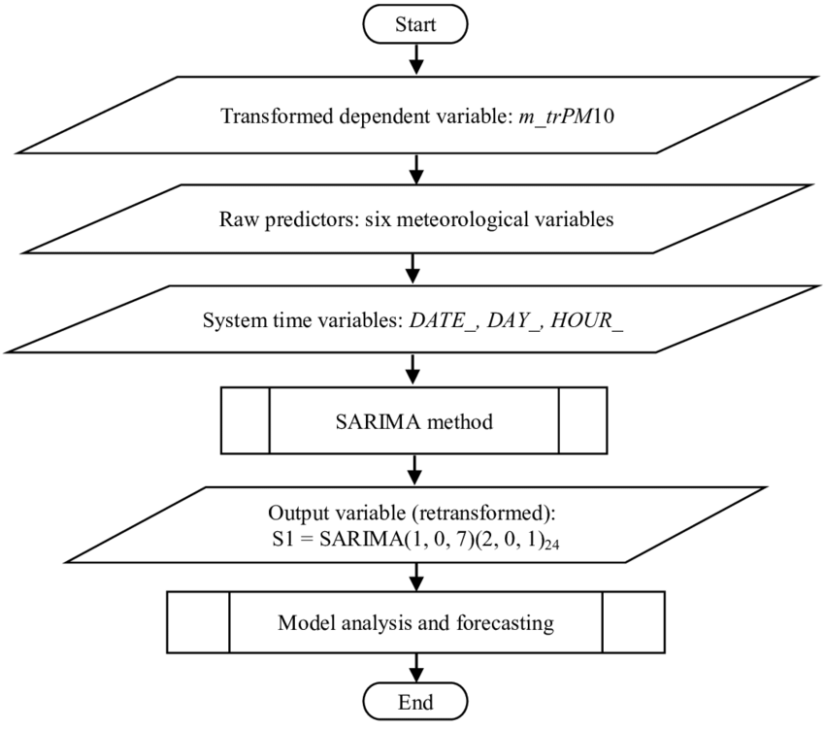
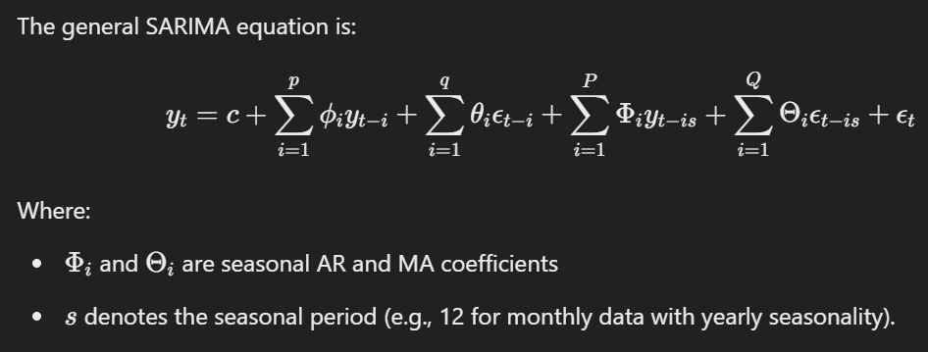
SARIMA
SARIMA, which stands for Seasonal Autoregressive Integrated Moving Average, extends ARIMA by adding seasonal components to account for patterns that repeat over a fixed period (seasonality).
SARIMA(p, d, q)(P, D, Q, s) where:
p,d,q are as in ARIMA
P,D,Q represent the seasonal part orders of AR, differencing, and MA
s is the length of the seasonal cycle
Fig 15: Block diagram of SARIMA model
Fig 16: Equation of SARIMA

Slide 23
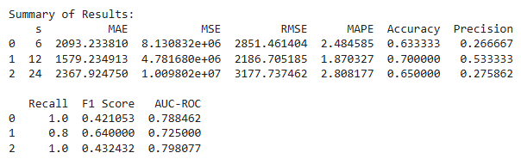
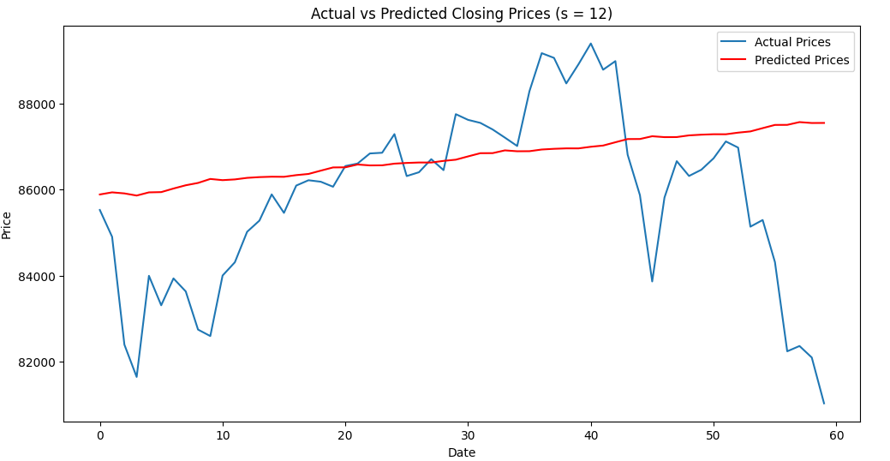
Fig 17: SARIMA model for different values of s

Slide 24
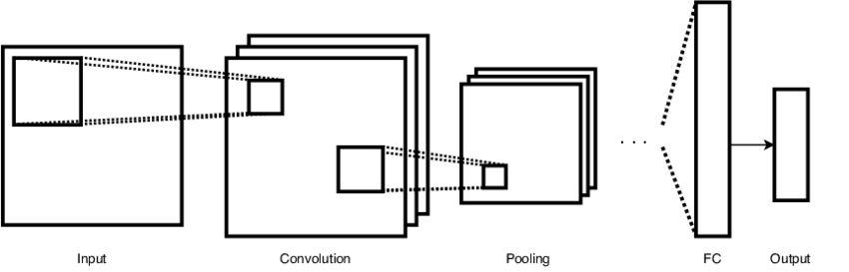
CNN
Convolutional Neural Networks (CNNs), traditionally used for image processing, are also effective for time series forecasting by capturing local patterns and trends in the data through convolution operations.
Convolution Layers: CNNs use filters to slide over input data, identifying local patterns like trends or seasonality.
Pooling: Pooling layers (e.g., max-pooling) reduce dimensionality, preserving key features while minimizing noise.
Feature Learning: Stacked convolutional layers extract higher-level, abstract features from the time series.
Fully Connected Layer: Flattened features are fed into a fully connected layer for final prediction.
Non-Linearity: Activation functions like ReLU introduce non-linearity, helping the model learn complex patterns.
Fig 18: Working of CNN
S(i,j) = ∑(m,n) W(m,n) * I(i+m, j+n) + b
Where:
S(i,j): The value of the output feature map at position (i, j).
W(m,n): The weight of the filter at position (m, n).
I(i+m, j+n): The value of the input image at position (i+m, j+n).
b: The bias term.
∑(m,n): Summation over all elements of the filter.
Fig 19: Equation of CNN

Slide 25
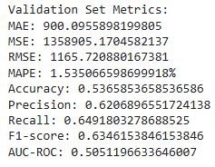
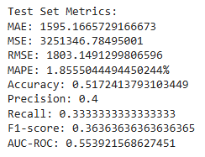
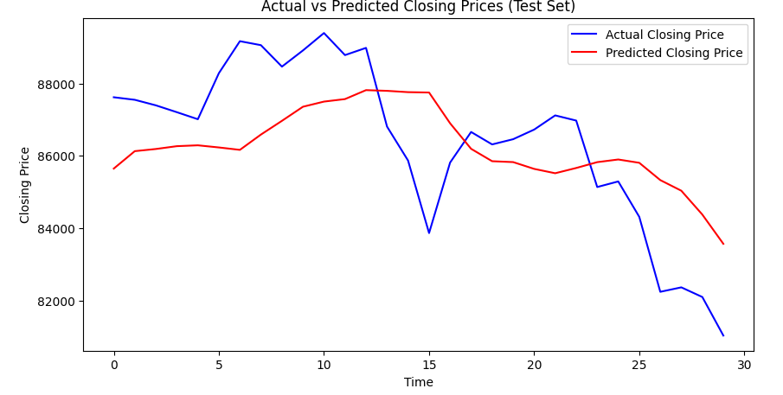
Fig 20: CNN 1-D model implementation with 50 Epochs

Slide 26
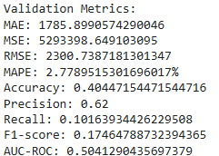
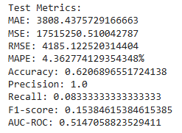
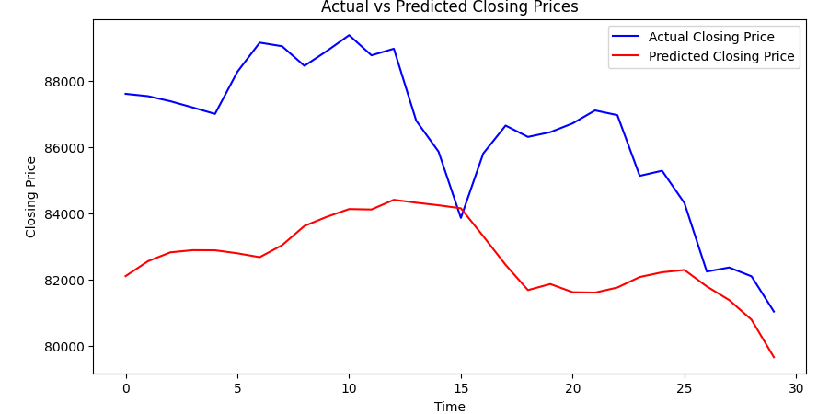
Fig 21: CNN 2-D model implementation with 50 Epochs

Slide 27
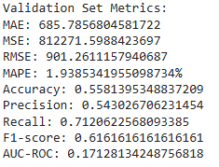
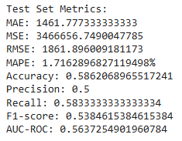
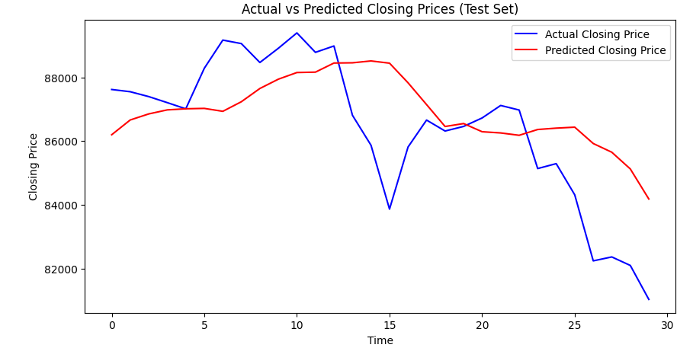
Fig 22: CNN 3-D model implementation with 150 Epochs

Slide 28
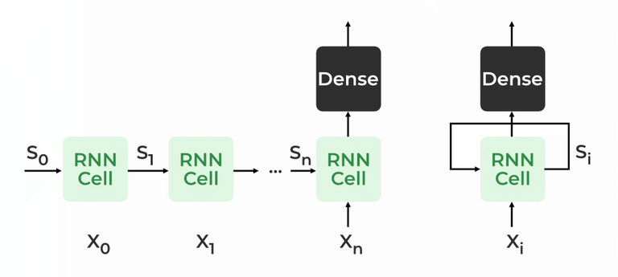
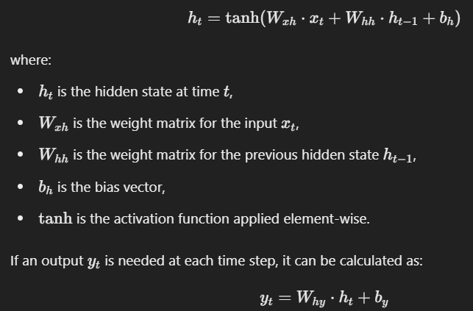
RNN
Recurrent Neural Networks (RNNs) are designed to handle sequential data, making them suitable for time series forecasting. They use feedback loops to process input sequences and maintain a hidden state that captures information from previous time steps.
Hidden State: RNNs maintain a hidden state hth_tht​ that updates at each time step ttt based on the current input xtx_txt​ and the previous hidden state ht−1h_{t-1}ht−1​.
Sequential Processing: The hidden state passes information from one time step to the next, capturing dependencies between the current and previous inputs.
Output: At each time step, the RNN produces an output yty_tyt​ based on the hidden state
Backpropagation Through Time (BPTT): During training, RNNs use BPTT to update weights by propagating errors backward through the sequence.
Fig 23: Working of RNN
Fig 24: Equation of RNN

Slide 29
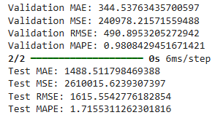
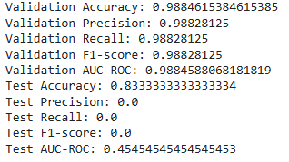
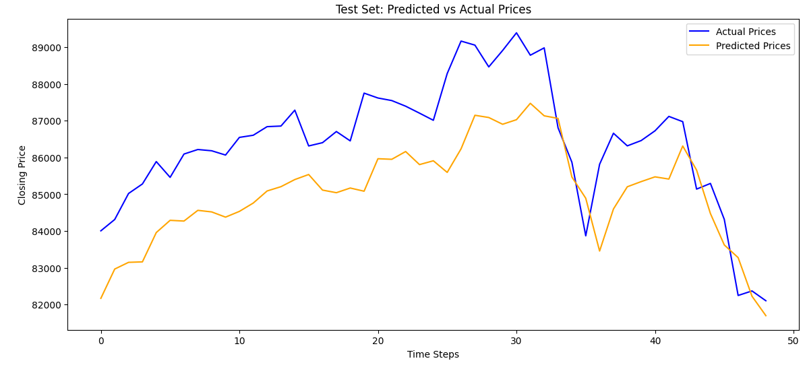
Fig 25: RNN model implementation with 100 Epochs

Slide 30
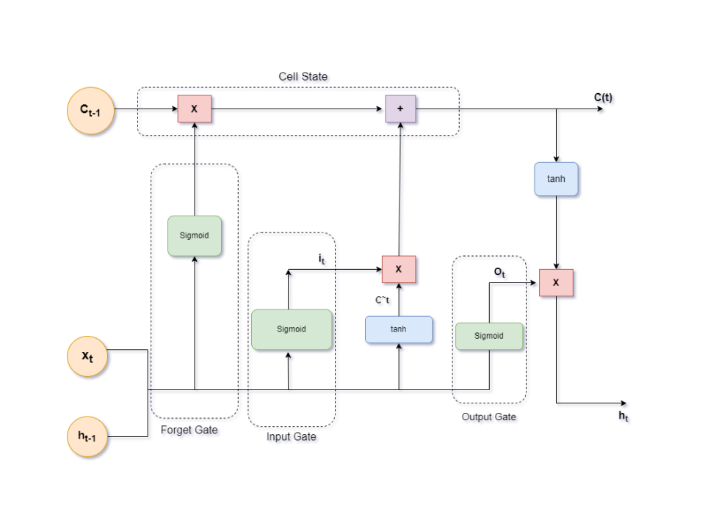
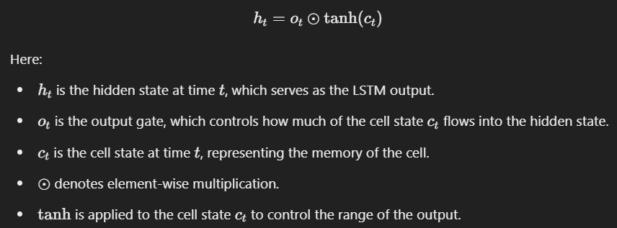
LSTM
LSTM (Long Short-Term Memory) is a type of recurrent neural network (RNN) designed to capture long-term dependencies in sequential data, making it highly effective for time series forecasting.
Memory Cells: LSTM units contain memory cells that maintain information over time, which helps the model remember patterns in the time series data.
Gates: LSTM uses three gates to control the flow of information: Forget Gate, Input Gate, Output Gate
Cell State Update: The cell state is updated based on the forget and input gates. It allows LSTM to carry forward relevant information and discard irrelevant data.
Fig 26: Architecture of LSTM
Fig 27: Equation of LSTM

Slide 31
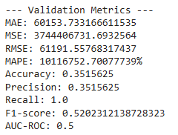
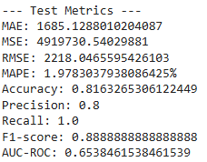
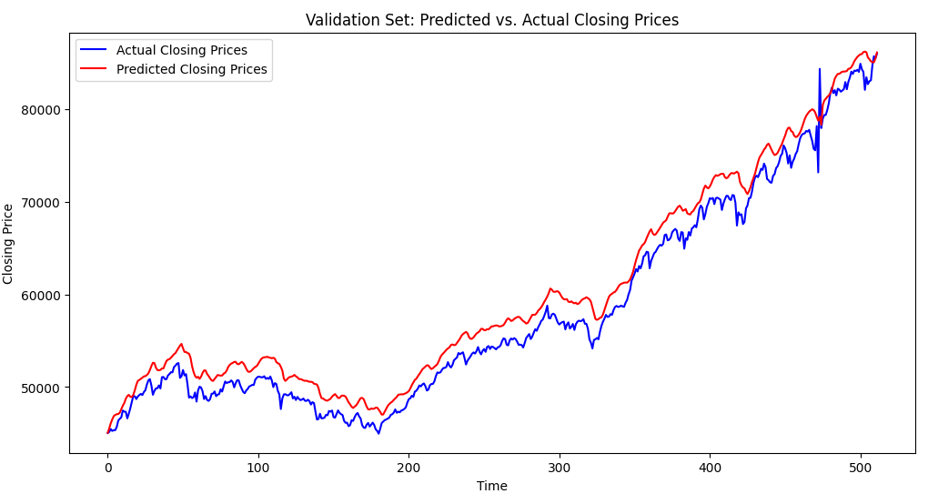
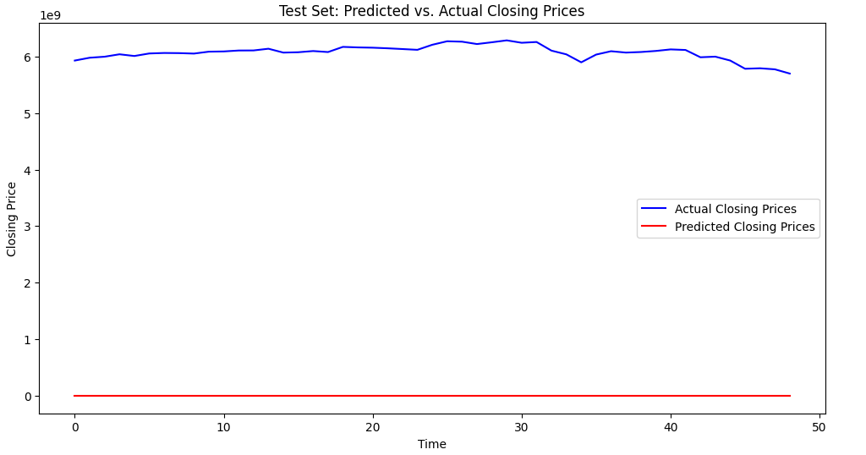
Fig 28: LSTM model implementation with 10 Epochs

Slide 32
CONCLUSION

Slide 33
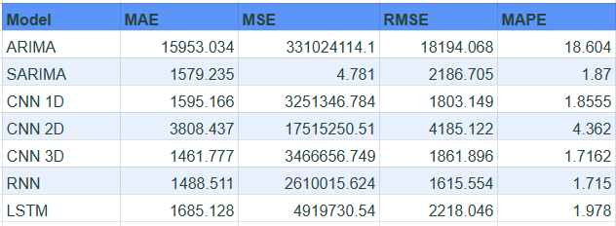
PROPOSED MODEL
Based on the given table, the best model appears to be the CNN 3D model:
It has the lowest MAE (1461.777), indicating that, on average, its predictions are closest to the actual values.
It has the lowest MAPE (1.7162), suggesting that its predictions are relatively accurate compared to the actual values.

Slide 34
Why CNN 3D Might Be Better:
Handling Temporal and Spatial Dependencies: CNN 3D models are well-suited for handling data with both temporal (time-series) and spatial (multi-dimensional) dependencies. This could be advantageous for certain types of time-series data with spatial components.
Feature Extraction: CNNs are excellent at automatically extracting relevant features from data, which can lead to improved performance.
However, it's important to consider the specific context and the goals of the analysis:
Trade-offs: There might be trade-offs between different models. For example, a model with a slightly higher MAE but significantly lower MAPE might be preferable in certain scenarios.
Domain Knowledge: Domain knowledge can play a crucial role in selecting the best model. If the underlying data has specific characteristics or patterns, a particular model might be more suitable.
Model Complexity: More complex models like CNN 3D might require more computational resources and training time.

Slide 35
FUTURE SCOPE/ GOAL
1. Hybrid Models:
Combining Deep Learning and Traditional Techniques: Explore the potential of hybrid models that integrate deep learning techniques with traditional statistical and econometric methods. This could involve using deep learning for feature extraction and traditional models for final forecasting.
Attention Mechanisms: Incorporate attention mechanisms to focus on the most relevant parts of the input sequence, potentially improving model performance and interpretability.
2. Multi-Task Learning:
Jointly Predicting Multiple Financial Variables: Develop models that can simultaneously predict multiple financial variables, such as stock prices, volatility, and trading volume. This can leverage shared information between different tasks and improve overall prediction accuracy.
Incorporating External Factors: Consider incorporating external factors, such as economic indicators, news sentiment, and social media data, to improve model performance.
3. Transfer Learning:
Leveraging Pre-trained Models: Utilize pre-trained deep learning models, such as those trained on large-scale image or text datasets, as a starting point for financial time series forecasting. This can help reduce training time and improve model performance.
Domain Adaptation: Develop techniques to adapt pre-trained models to specific financial domains, such as stock markets or cryptocurrency exchanges.

Slide 36
4. Explainable AI:
Model Interpretability: Develop methods to interpret the decisions made by deep learning models, making them more transparent and understandable. This can help build trust in the models and identify potential biases.
Feature Importance Analysis: Analyze the importance of different input features to the model's predictions, providing insights into the underlying patterns in the data.
5. Real-Time Forecasting:
Online Learning: Develop models that can continuously learn and adapt to new data as it becomes available, enabling real-time forecasting.
Low-Latency Inference: Optimize models for efficient inference on edge devices, enabling real-time decision-making.
6. Ethical Considerations:
Fairness and Bias: Address potential biases in the training data and models to ensure fair and equitable predictions.
Responsible AI: Develop guidelines and practices for the responsible development and deployment of AI-powered financial systems.

Slide 37
REFERENCES

Slide 38
Yuan Zhao, Weiguo Zhang, Xiufeng Liu. (2024). "Grid search with a weighted error function: Hyper-parameter optimization for financial time series forecasting." Elsevier: Applied Soft Computing​.
Tanya Srivastava, Ishita Mullick, Jatin Bedi. (2024). "Association mining-based deep learning approach for financial time-series forecasting." Elsevier: Applied Soft Computing​..
ZHANG, Can, ZHOU, Zhanxin, WU, Ruibo. (2024). "Analyzing and predicting financial time series data using Recurrent Neural Networks." JIEAS: Journal Of Industrial Engineering and Applied Science.
Zhen Fang, Xu Ma, Huifeng Pan, Guangbing Yang, Gonzalo R. Arce. (2022). "Movement forecasting of financial time series based on adaptive LSTM-BN network." Elsevier: Expert Systems with Applications.
Kelum Gajamannage, Yonggi Park, Dilhani I. Jayathilake. (2023). "Real-time forecasting of time series in financial markets using sequentially trained dual-LSTMs." Elsevier: Expert Systems with Applications​.
Dawei Cheng, Fangzhou Yang, Sheng Xiang, Jin Liu. (2021). "Financial time series forecasting with multi-modality graph neural network." Elsevier: Pattern Recognition​.
Sudersan Behera, Sarat Chandra Nayak, A. V. S. Pavan Kumar. (2023). "A Comprehensive Survey on Higher Order Neural Networks and Evolutionary Optimization Learning Algorithms in Financial Time Series Forecasting." Springer: Archives of Computer Methods in Engineering​.

Slide 39
Tong Niu, Jianzhou Wang, Haiyan Lu, Wendong Yang, Pei Du. (2020). "Developing a deep learning framework with two-stage feature selection for multivariate financial time series forecasting." Elsevier: Expert Systems with Applications​.
Guancen Lin, Aijing Lin, Jianing Cao. (2020). "Multidimensional KNN algorithm based on EEMD and complexity measures in financial time series forecasting." Elsevier: Expert Systems with Applications​.
Rohit Salgotra, Harmanjeet Singh, Szymon Lukasik, Gurpreet Kaur, Supreet Singh, Pratap Singh. (2024). "A hybrid deep learning model combining Bi-directional Gated Recurrent Unit (BGRU) with a Convolutional Neural Network (CNN) for predicting the closing prices of stock indices in six Asian stock markets." MDPI: Algorithms​.
Miguel Noguer i Alonso, Rodolfo Pereira Franklin. (2024). "Large Language Models for Financial Time Series Forecasting." SSRN.
Mohamat Setiawan, Ade Johar Maturidi, Dian Novianti. (2024). "Evaluation of the Multiple Regression Analysis Algorithm on Stock Market Prediction." ANN Publishers: Journal of Engineering Sciences.
Barın Batu. (2024). "Investigating Performance of ESNs in Forecasting Financial Metrics When Compared To Traditional RNN Types." International Journal of Social Science and Economic Research​.
Darko B. Vuković, Sonja D. Radenković, Ivana Simeunović, Vyacheslav Zinovev, Milan Radovanović. (2024). "Predictive Patterns and Market Efficiency: A Deep Learning Approach to Financial Time Series Forecasting." MDPI: Mathematics​.

Slide 40
Ali Mehrabian, Ehsan Hoseinzade, Mahdi Mazloum, Xiaohong Chen. (2024). "Mamba Meets Financial Markets: A Graph-Mamba Approach for Stock Price Prediction." arXiv: Computational Finance​.
Yuxi Liu. (2024). "The Investigation of the Application of Apache Spark in Stock Analysis." Proceedings of the 1st International Conference on Engineering Management, Information Technology and Intelligence​.
John Kamwele Mutinda, Amos Kipkorir Langat. (2024). "Stock price prediction using combined GARCH-AI models." Elsevier: Scientific African.
Md. Morshed Bin Shiraj, Md. Mizanur Rahman, Md. Al-Imran, Mst Zinia Afroz Liza, Md. Masum Murshed, Nasima Akhter. (2024). "Anomaly detection in financial time series data via mapper algorithm and DBSCAN clustering." World Journal of Advanced Engineering Technology and Sciences​.
Mahsa Tajik Gholami, Ali Shahabi. (2024). "Comparison of Deep Learning Methods with Traditional Financial Time Series Models for Forecasting the Tepix Index in the Tehran Stock Exchange." SSRN​.
Omer Berat Sezer, Mehmet Ugur Gudelek, Ahmet Murat Ozbayoglu. (2020). "Financial time series forecasting with deep learning: A systematic literature review: 2005–2019." Elsevier: Applied Soft Computing Journal​.
Cheng Zhang, Nilam Nur Amir Sjarif, Roslina Ibrahim. (2023). "Deep learning models for price forecasting of financial time series: A review of recent advancements: 2020–2022." Wiley: WIREs Data Mining and Knowledge Discovery​

Slide 41
THANK
YOU

